Slide 1



AI-POWERED ELECTRICAL LAB ASSISTANT
DONE BY:
NITHIYA SRI.T
SOFIKA.M
BS ABDUR RAHMAN CRESCENT INSTITUTE OF SCIENCE AND TECHNOLOGY

Slide 2
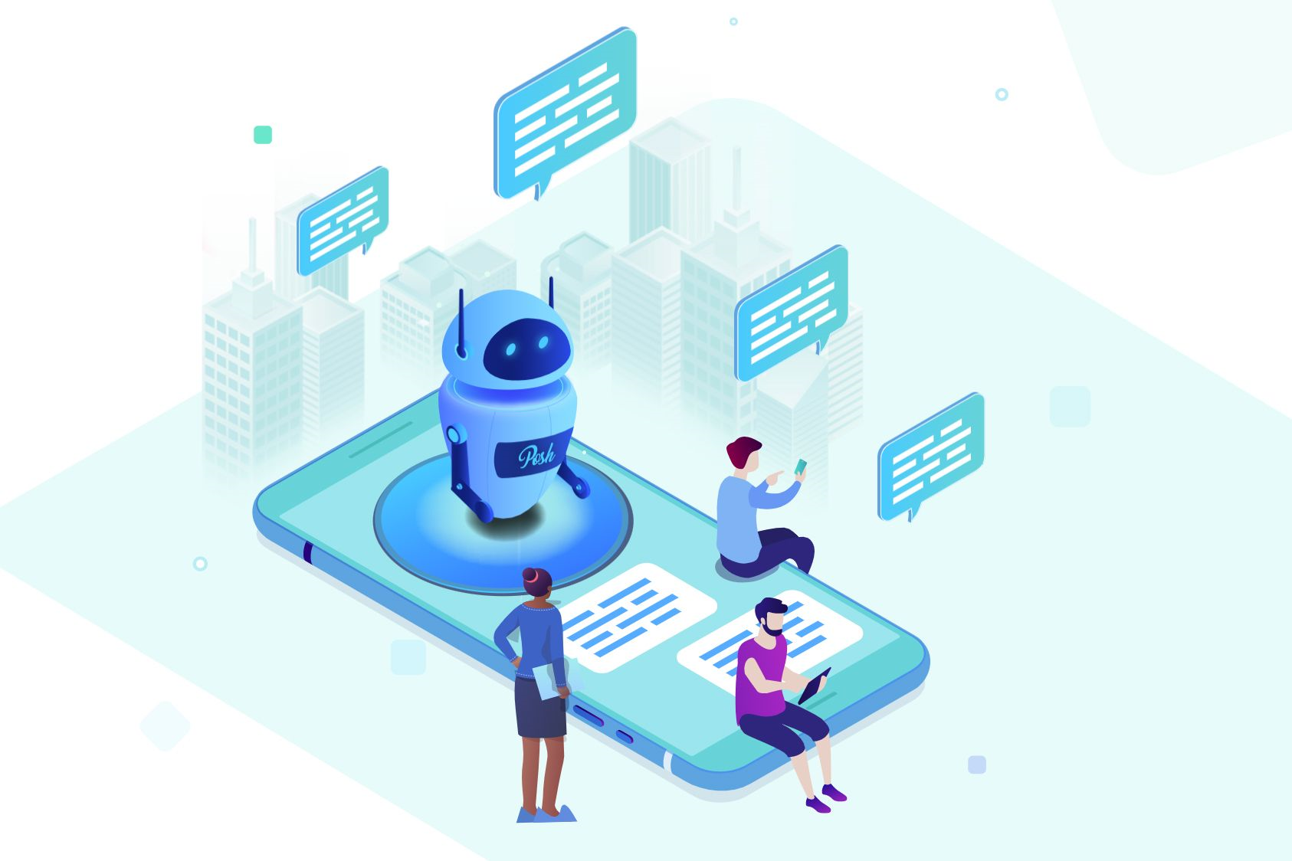
ABOUT SCI-PAL
Sci-Pal is an AI-powered electrical lab assistant which represents the fusion of cutting-edge technology with traditional scientific experimentation. Imagine walking into a laboratory filled with buzzing equipment and intricate circuits, and instead of relying solely on human expertise, you have an intelligent AI system seamlessly integrated into the workflow.

Slide 3

WHY SCI-PAL
Sci-Pal can provide immediate responses to inquiries, reducing the time students spend waiting for assistance. This rapid response time enhances productivity and allows students to stay focused on their experiments. By leveraging chatbot technology, laboratories can optimize their operations and support the research community more effectively.

Slide 4
01
PROBLEMS FACED
01
Students may have to wait for a lab instructor or teaching assistant when they need help during experiments. This delay can slow progress and cause frustration.
02
Instructors might give inconsistent guidance, confusing students. Without a centralized assistance system, students get conflicting information, hindering their understanding and troubleshooting.
03
Students face difficulties diagnosing and resolving technical issues during experiments without access to comprehensive troubleshooting resources. This can waste valuable time and resources.
04
In traditional labs, instructors struggle to offer personalized help due to time constraints and diverse student backgrounds. This can hinder students' success.

Slide 5
01
METHODOLOGIES USED
Sci-Pal os built using AWS, which involves several methodologies and services. Here's an overview of the typical steps involved:
1.Define Use Cases: Begin by defining the use cases and functionality we want for chatbot to support. Determine the types of interactions it will handle, such as answering questions, providing guidance, or assisting with troubleshooting.
2.Choose AWS Services: Select the AWS services that best suit chatbot's requirements. Commonly used services include Amazon Lex for natural language understanding and conversational interfaces, Amazon Polly for text-to-speech conversion, and Amazon S3 for storing chatbot data and resources.

Slide 6
3.Design Conversation Flows: Design the conversation flows and dialogues that chatbot will follow. Define the intents (actions) and slots (parameters) that the chatbot will recognize, as well as the responses it will provide based on user input.
4.Develop and Train the Bot: Develop and train the chatbot using Amazon Lex. Define sample utterances for each intent and provide corresponding responses. Use the built-in machine learning capabilities of Lex to train the bot to understand user inputs and generate appropriate responses.
5.Integrate External Services: Integrate the chatbot with external services as needed. For example, you might integrate with AWS Lambda functions to perform backend processing, or with Amazon DynamoDB to store and retrieve data.

Slide 7
6.Test and Iterate: Test the chatbot thoroughly to ensure that it functions correctly and provides accurate responses. Iterate on the design and training of the bot based on user feedback and testing results.
7.Deploy the Chatbot: Deploy the chatbot to make it accessible to users. You can deploy it on various platforms, such as websites, messaging apps, or mobile apps, depending on your target audience.
8.Monitor and Maintain: Continuously monitor the performance of chatbot, which is Sci-Pal and gather metrics on user interactions. Use this data to identify areas for improvement and update the chatbot accordingly.
Throughout this process, AWS provides a range of tools and services to support the development, deployment, and management of Sci-Pal, making it easier to build robust and scalable conversational interface.

Slide 8
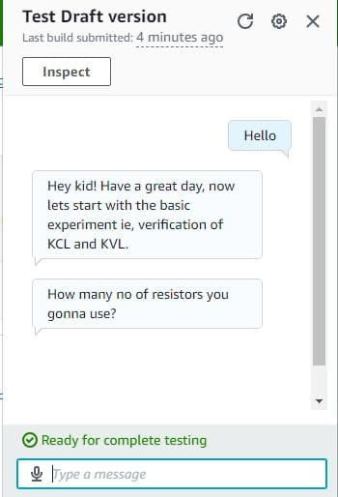
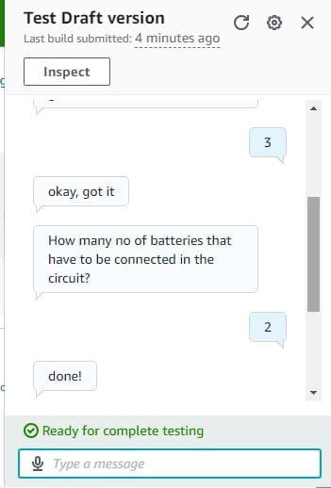
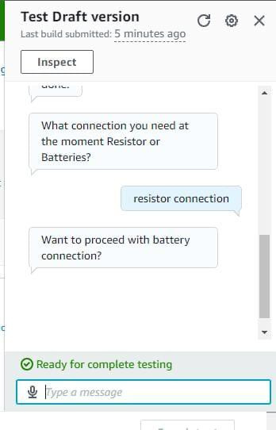
RESULT
Fig. 1
Fig. 2
Fig. 3

Slide 9
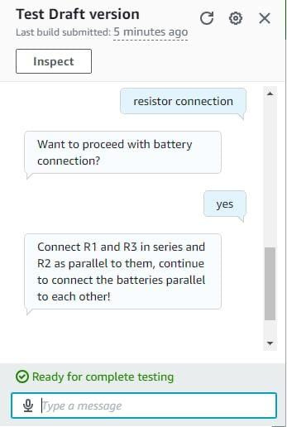
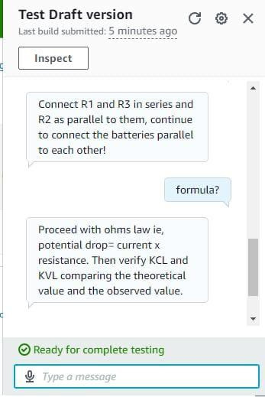
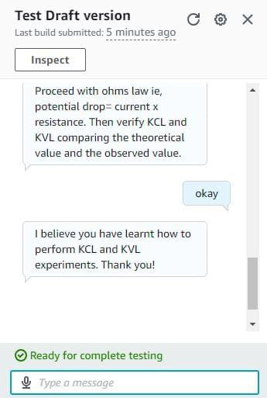
Fig. 4
Fig. 5
Fig. 6

Slide 10
ADVANTAGES
DISADVANTAGES
Improved Accessibility: Sci-Pal provides immediate assistance to students, enhancing accessibility to support resources at anytime, anywhere.
Technical Expertise Required: Building and maintaining a chatbot demands technical skills, challenging for institutions with limited expertise.
01
01
Consistent Guidance: Students receive consistent guidance and explanations, reducing confusion and improving their understanding of concepts.
Communication Constraints: Understanding non-standard language may pose challenges for chatbots.
02
02
Maintenance: Regular updates and maintenance are necessary to keep chatbots functional and effective.
Enhanced Learning Experience: Smoother lab experiences lead to better academic outcomes.
03
03

Slide 11
CONCLUSION
REFERENCE
In summary, while chatbots offer significant benefits like improved accessibility and efficient troubleshooting, challenges such as technical expertise requirements, initial costs, and dependency on technology need to be addressed. Despite these hurdles, with careful planning and investment, Sci-Pal can greatly enhance the student experience in electrical labs, fostering better learning outcomes.
https://www.researchgate.net/publication/362412596_ARTIFICIAL_INTELLIGENCE_AI_AND_INDIAN_EDUCATION_SYSTEM_PROMISING_APPLICATIONS_POTENTIAL_EFFECTIVENESS_AND_CHALLENGES
Russell, S.J, & Norvig, P. (2010). Artificial intelligence: a modern approach, (3rd ed.). Upper Saddle River: Prentice-Hall. In Popenici, S.S.D, & Kerr, S. (2017). Exploring the impact of artificial intelligence on teaching and learning in higher education. Research and Practice in Technology Enhanced Learning, 12(12), 1-13. Retrieved as on August 8, 2021 from https://telrp.springeropen.com/articles/10.1186/s41039-017-0062-8

Slide 12
THANK YOU
ANY QUESTIONS?

